Slide 1
Comprehensive Digital Marketing for Britannia
Presented By:-
S. Poornima
R. Amulya
G. Kiran Kumar
M. Dileep Kumar
J. Bala Murali Krishna
Here is where our presentation begins

Slide 2

-“Eat Healthy Think Better”
Britannia Industries Limited is an Indian food products corporation based in Bangalore, India.
It was the first bakery Company in India to remove transfats from its Biscuits.
It was established in 1892 by a group of British Businessman

Slide 3
Product Mix
Biscuits
Breads
Dairy
Rusk
Cakes
Good Day
Marie
Nutri Choice
Tiger
50-50
Bourbon
Milk bikis
Treat
Little hearts
Cookies
Pure Magic
Time Pass
White Sandwich
Breads
Whole Wheat Breads
Honey & Oats
Breads
Multi-Grain Breads
Multi-Fiber Bread
Premium Bake
Suji Toast
Muska Rusk
Cheese
Butter
Ghee
Curd
Milk
Dairy Whitener
Gourmet Cheese
Actimind
Bar Cakes
Chunk Cake
Cup Cakes
Veg-Cakes
Nut& Raisin
Romance
Muffils

Slide 4
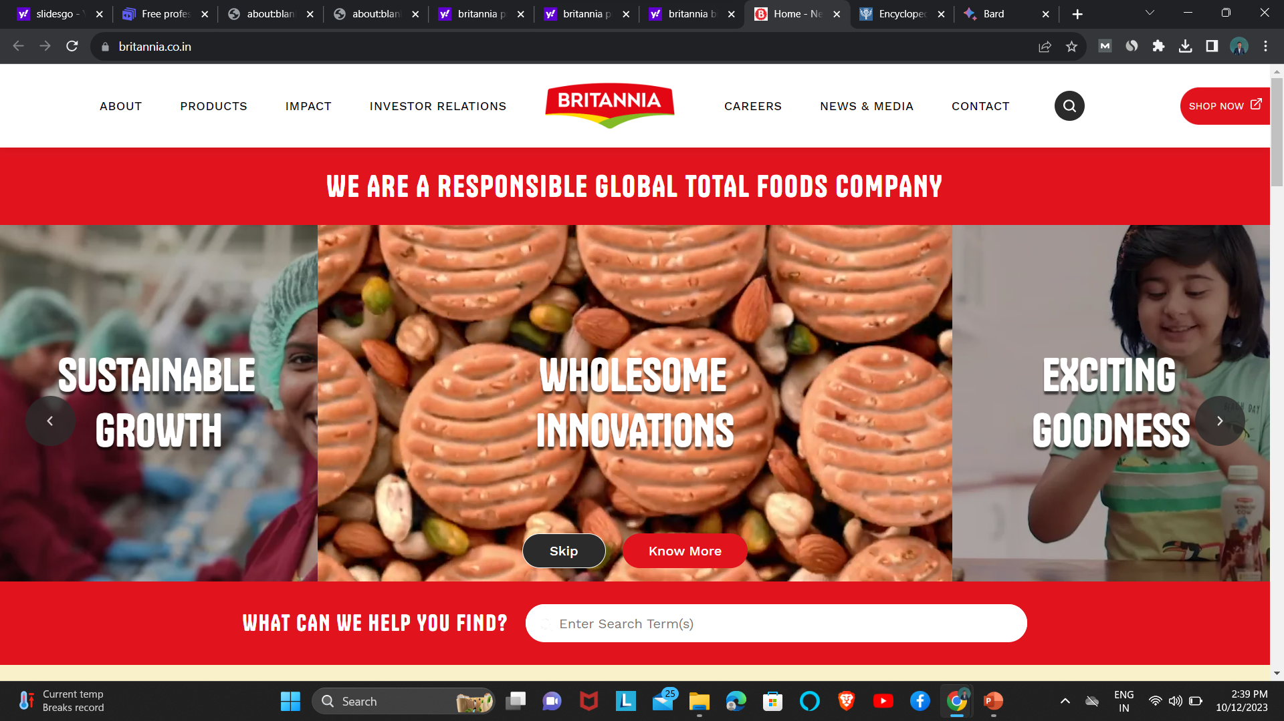
Digital Marketing
Britannia's digital marketing strategy is focused on:
Creating engaging content
Building relationships with customers
Promoting products in a creative and effective way
Collecting data to improve products and services
Britannia uses digital marketing to connect with customers and learn about their needs, so it can create and promote products that they love.

Slide 5
Brand Study
Britannia's success is due to its focus on:
Customer needs: Britannia conducts regular market research and has a strong customer feedback mechanism to understand and meet the changing preferences of its customers.
Innovation: Britannia regularly launches new products and variants, and invests heavily in research and development to improve its products and processes.
Short version: Britannia's success is due to its focus on customer needs and innovation.

Slide 6
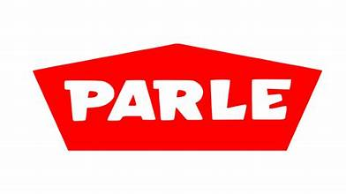


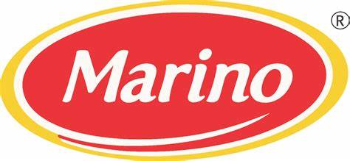


Competitors Analysis
Parle Products – 23%
ITC Foods – 18%
Mondelez
International – 10%
Venus
Venus has a beautiful name and is the second planet from the Sun. It’s terribly hot
Others – 17%

Slide 7
Buyers Persona
Britannia's food buyers are people of all ages, genders, and income levels who live in India. They are looking for high-quality, affordable food products that are convenient to purchase and consume. Britannia's audience persona is diverse, but some common characteristics include:
Family-oriented
Budget-conscious
Convenience-driven
Health-conscious

Slide 8

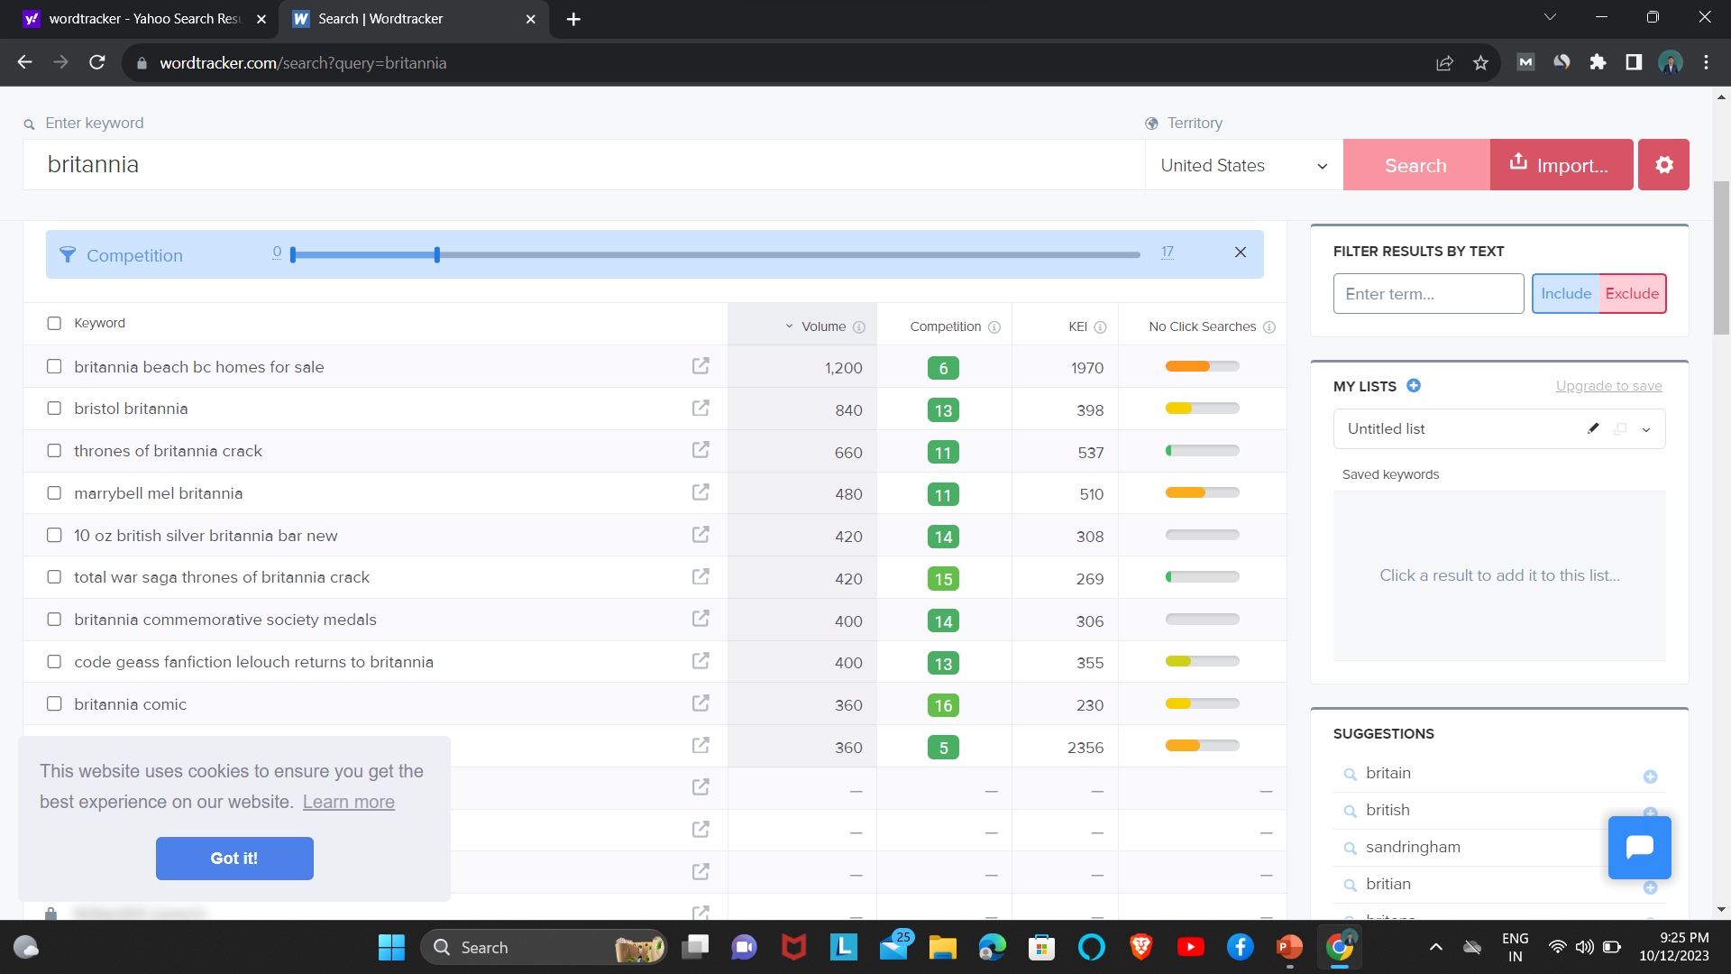
SEO & Keyword Research
SEO is the process of optimizing a website to rank higher
in search engine results pages (SERPs). This is done by improving the website’s technical structure, creating high-quality content, and building backlinks
Here are the specific keywords that rank in Search engines:-
Britannia Good Day biscuits
Britannia Milk Bikis biscuits
Britannia Marie biscuits
Britannia Little Hearts biscuits
Britannia 50-50 biscuits
Britannia NutriChoice biscuits

Slide 9
Content Ideas
Product Overview
Manufacturing process
Marketing campaigns
New product launches
Consumer testimonials

Slide 10
Marketing Strategies
Focus on customer needs:
Innovation:
Strong brand image
Effective marketing campaigns:
New product launches:
Social media marketing
Digital Marketing

Slide 11
Content Creation & Curation
Blog posts about the history of Britannia, its products, and its social responsibility initiatives.
Recipes that use Britannia biscuits.
Product reviews of Britannia biscuits.
Videos of Britannia biscuits being made or used in recipes.
Social media posts about Britannia biscuits, such as photos, videos, and infographics.

Slide 12
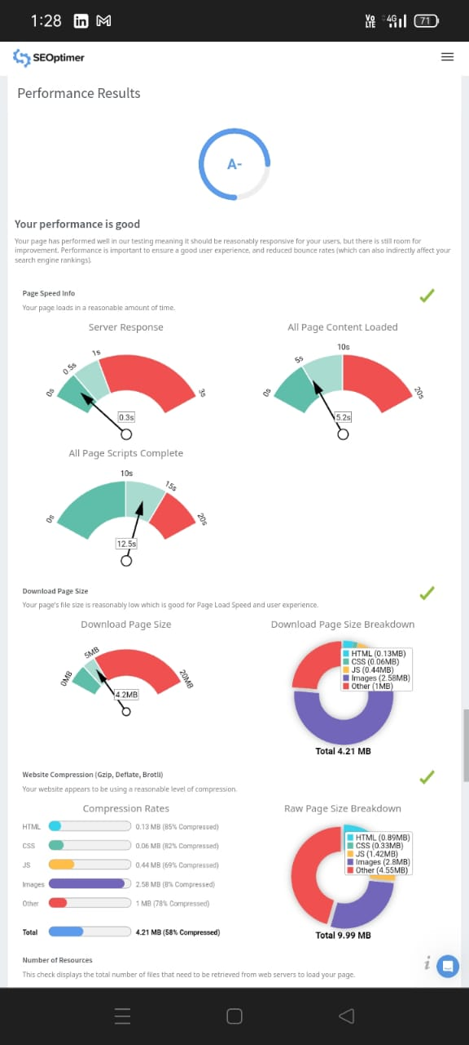
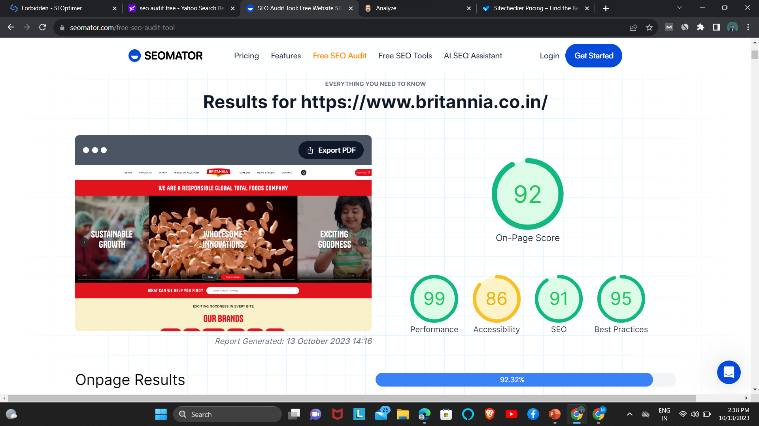
Audit Report of Britannia’s

Slide 13
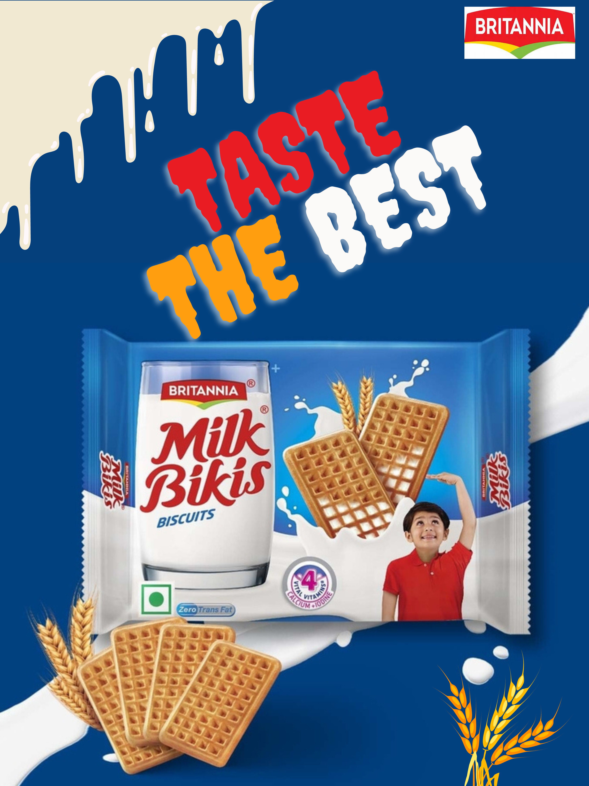
Poster Design

Slide 14
Instagram Reel
This is our Brand Promotional Instagram reel
Click Here

Slide 15
Thanks For Your Courtesy!
-From Gayatri college of science and Management

